Slide 1




E-COMMERCE
DATA
Case Study Analysis
MOATAZ ELMESMARY
12 JULY, 2025

Slide 2
TABLE OF CONTENTS
Insights
Summary (KPIs)
Key Insights from
Visuals
Recommendations

Slide 3
INSIGHTS SUMMARY
✅ Key KPIs Calculated:
Total Orders: 1000
Confirmed Orders: 948 → 📈 Order Confirmation Rate: 94.8%
Shipped Orders: 917 → 🚚 Ship Rate: 97%
Delivered Orders: 844 → 📦 Delivery Rate: 92%
Delivery On Time %: ⏰ 50%

Slide 4
KEY INSIGHTS FROM THE VISUALS:
1. Performance by Supplier:
Samsung, Vodafone, Huawei are top suppliers, each contributing over 200 orders.
Apple is the lowest among the top 5 (185 orders), which may indicate underperformance or limited stock.
2. Orders by Channel:
Call Center is the most used channel (351 orders), followed closely by App (339), then Website (310).
However, the delivery rate by channel shows Call Center has lower on-time delivery, indicating possible inefficiencies

Slide 5
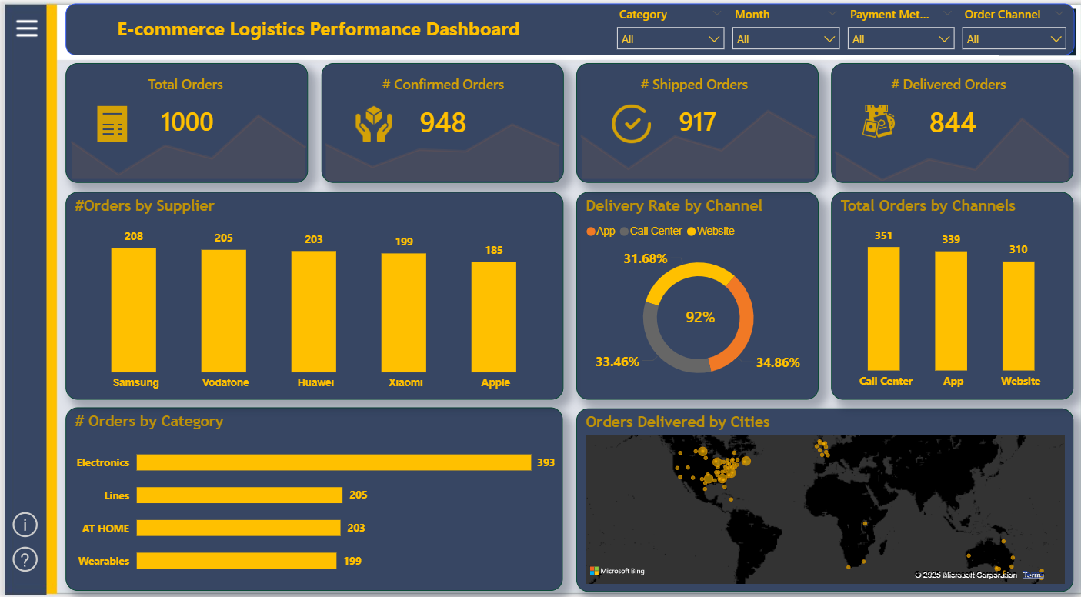
KEY INSIGHTS FROM THE VISUALS:

Slide 6
KEY INSIGHTS FROM THE VISUALS:
3. Product Trends:
Top products by order: Smartphone, SIM Card, Router, Smartwatch, Tablet.
These align with top suppliers and highlight strong demand for mobile tech products.
4. Category Distribution:
Electronics dominate (393 orders), indicating a heavy focus on tech products.
"AT HOME" and "Lines" are also strong categories, while "Wearables" has the least.
5. Delivery Partners Performance:
Aramex has the highest deliveries (233), followed by DHL and FedEx.
Gap between total orders and delivered orders across all partners exists, especially for Bosta, suggesting improvement needed in fulfillment.

Slide 7
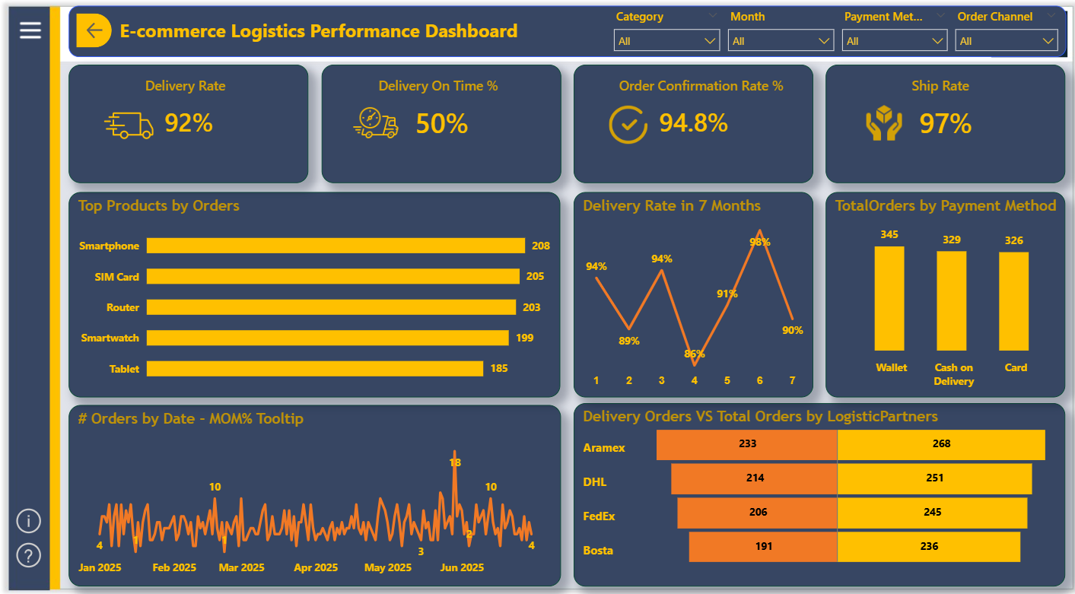
KEY INSIGHTS FROM THE VISUALS:

Slide 8
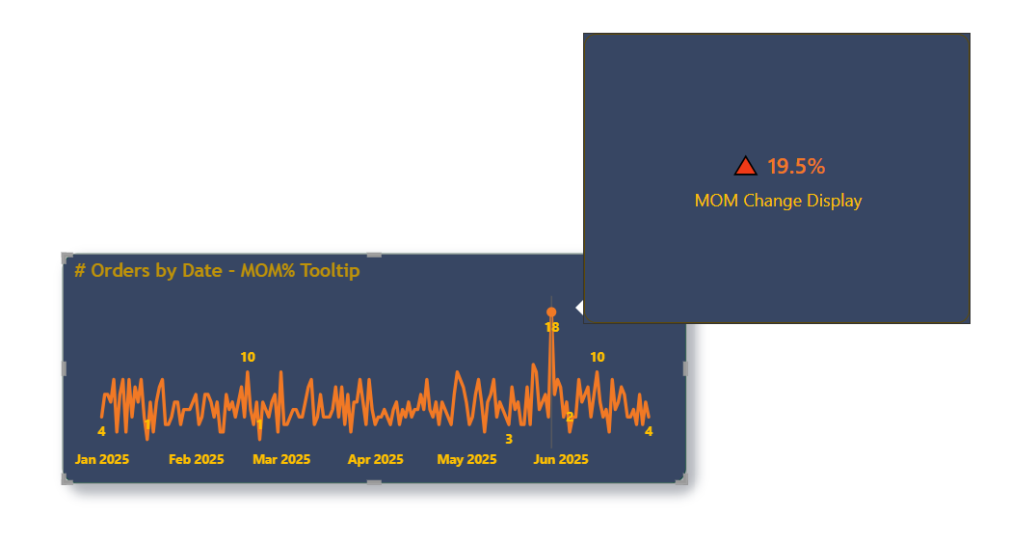
MONTH OVER MONTH WITH TOOLTIP (MOM %)

Slide 9
KEY INSIGHTS FROM THE VISUALS:
6. Payment Methods:
Balanced usage across Wallet (345), Cash on Delivery (329), and Card (326).
Slight preference for Wallet, could be leveraged for digital promotions.
7. Monthly Delivery Trends:
Delivery rate dropped in month 4 (85%), then peaked in month 6 (98%).
Suggests an operational bottleneck in month 4, and potential improvement actions applied afterward.
8. Geographic Insights:
Majority of orders delivered in Middle East, Europe, and Africa.
Visualization indicates wide delivery network but concentrated activity in specific zones.

Slide 10
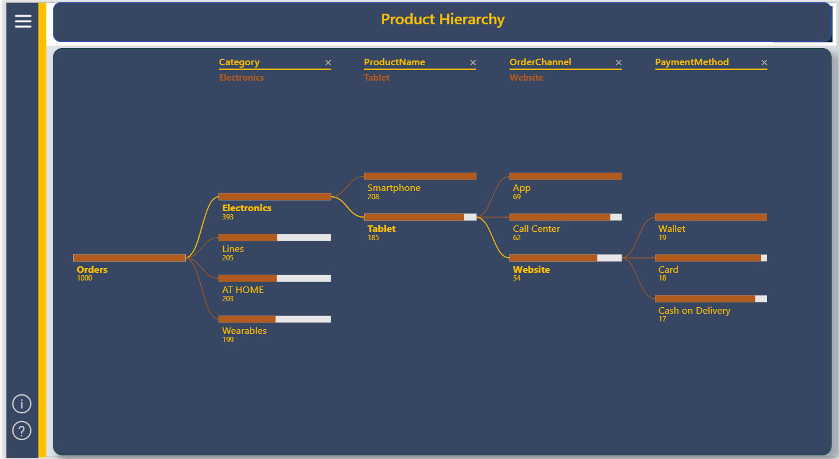
KEY INSIGHTS FROM THE VISUALS:

Slide 11
RECOMMENDATIONS:
Recommendations:
Improve delivery on-time rate (currently 50%) through better logistics scheduling or partner SLAs.
Focus on improving Call Center delivery performance, as it has high volume but potential delay issues.
Explore AI-based demand forecasting for top categories like Electronics to optimize stock.
Investigate performance gaps in Bosta's fulfillment and delivery timelines.
Leverage the strong Wallet usage with targeted loyalty programs or cashback offers.

Slide 12
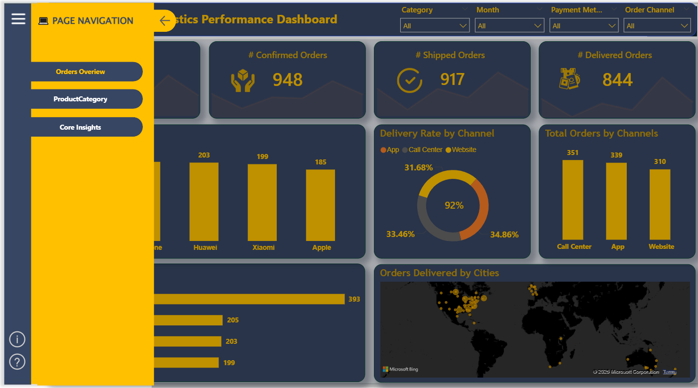
NAVIGATION?

Slide 13
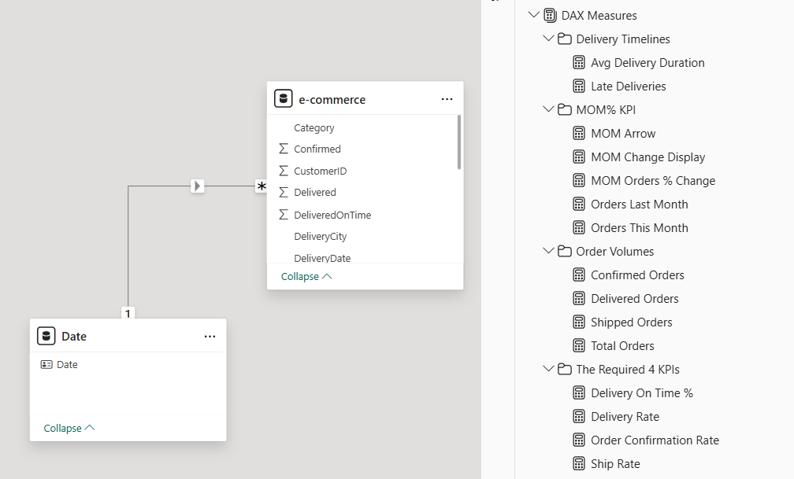
FULL MEASURES

Slide 14




THANK YOU
+20 100 0033 506
moataz.mesmary@gmail.com
https://moatazelmesmary.vercel.app/
Cairo, Egypt

